Slide 1
Information
Effective information management must begin by thinking about how people use information—not with how people use machines.
Thomas Davenport

Slide 2
Key characteristics of the early 21st century
High velocity global change
Changing international relationships
Emergence of China as an economic power
Trading blocs
Globalization of business
Emergence of influential information-based organizations
Apple - iPhone and iTunes
eBay - The World’s Online Marketplace®
Google - to organize the world's information and make it universally accessible and useful
Facebook – social media
Microsoft - Windows and Office
SAP - enterprise resource planning software

Slide 3
Economies and IS
Economy | Subsistence | Agricultural | Industrial | Service | Sustainable
Question | How to survive? | How to farm? | How to manage resources? | How to create customers? | How to reduce impact?
Dominant issue | Survival
 |  | Production
 |  |  |  | Customer service
 |  |  |  |  | Sustainability
Key information systems | Gesture Speech | Writing Calendar | Accounting ERP Project management | CRM Analytics | Simulation Optimization Design

Slide 4
Exercise
What changes have you observed that indicate a shift in the dominant logic towards sustainability?

Slide 5
Wealth creation
Old wealth | New wealth
Military | Intelligence
Natural resources | Marketing
Population | Global reach
Industry | Education

Slide 6
The information age
Built on sand
Silicon chips
Fiber optics
Borderless
A free flow of:

Slide 7
Eras of information systems
Era | Focus | Period | Technology | Networks
1 | Take information work to the computer | 1950s – mid-1970s | Batch | Few data networks
2 | Take information work to the employee | Mid-1970s – mid-1990s | Host/terminal | Spread of private networks
3 | Take information work to the customer and other stakeholders | Mid-1990s - present | Browser/server | Public networks

Slide 8
How IS creates value
Who | Every time an organization makes contact with a stakeholder, it has an opportunity to influence, inform, or transfer work to the stakeholder.
How | How an organization reaches a stakeholder determines the potential success of the interaction. The higher the bandwidth of the connection, the richer the message, the greater the amount of information that can be conveyed, and the more information work that can be transferred.
Where | Value is created when customers get information directly related to their current location and what local services they want to consume.
When | When a firm delivers a service to a client can greatly determine its value.

Slide 9
Knowledge transfer
Writing and paper enable accumulation and transmission of knowledge
Writing encodes information
Full writing systems are 5,000 years old
Storage medium has progressed from clay to solid state memory
Large scale organizational memory parallels development of large organizations

Slide 10
Information hardness
Minerals | Scale | Data
Talc | 1 | Unidentified source-rumors, gossip, and hearsay
Gypsum | 2 | Identified nonexpert source - opinions, feelings, ideas
Calcite | 3 | Identified expert source - predictions, speculations, forecasts, estimates
Fluorite | 4 | Unsworn testimony - explanations, justifications, assessments, interpretations
Apatite | 5 | Sworn testimony - explanations, justifications, assessments, interpretations
Orthoclase | 6 | Budgets, formal plans
Quartz | 7 | News reports, non-financial data, industry statistics, survey data
Topaz | 8 | Unaudited financial statements, government statistics
Corundum | 9 | Audited financial statements, government statistics
Diamond | 10 | Stock exchange and commodity market data

Slide 11
Information richness
Richest |  |  |  | Leanest
Face-to-face | Telephone | Personal documents (letters and memos) | Impersonal written documents | Numeric documents
Managers seek rich information to resolve equivocality
Information systems typically deliver lean information

Slide 12
Information classes
Class | Description
Content | Quantity, location, and types of items
Form | Shape and composition of an object
Behavior | Simulation of a physical object
Action | Creation of action (e.g., industrial robots)

Slide 13
Information and organizational change
Organizations are goal seeking
Information supports goal seeking

Slide 14
Goal setting information
Anchoring and adjusting
Planning
Demographic trends
Economic forecasts
Benchmarking
Competitors’actions

Slide 15
Gap information
Problem identification
A gap between expectations and performance
Scorekeeping
Quantitative
Qualitative
Use of critical success factors to determine variables to measure

Slide 16
Gap information
Detecting the gap
Problem identification
Exception reports
Scorekeeping
Routine reports

Slide 17
Scorekeeping
Orders | Number of current customers
 | Average order size
 | Batting average (orders to calls)
Sales volume | Dollar sales volume
 | Unit sales volume
 | By customer type
 | By product category
 | Translated to market share
 | Quota achieved
Margins | Gross margin
 | Net profit
 | By customer type
 | By product
Customers | Number of new accounts
 | Number of lost accounts
 | Percentage of accounts sold
 | Number of accounts overdue
 | Dollar value of receivables
 | Collection of receivables

Slide 18
Change information
Closing the gap
Problem solution
Determining the cause(s)
Identifying alternatives
Analysis of alternatives

Slide 19
Information as a means of change
Information can be a source of competitive advantage
Information can be built into products and services
Marketing
Frequent flyer programs
Customer service
Information technology used to improve service
Empowerment
Sharing information with employees
Giving employees freedom to make decisions

Slide 20
Managerial work
Managers implement organizational change
Managerial work is:
Fragmented
Brief
Frequently disturbed
High velocity
Action oriented rather than contemplative

Slide 21
Exercise
Identify some products that incorporate information as a differentiating feature

Slide 22
Managerial communication
Preference for oral communication
Extensive use of networks
Information source
Way of getting things done
Formal reporting systems
Infrequently used
Source of confirming information

Slide 23
Managerial information requirements
Expect relevant information
Expectations continually change

Slide 24
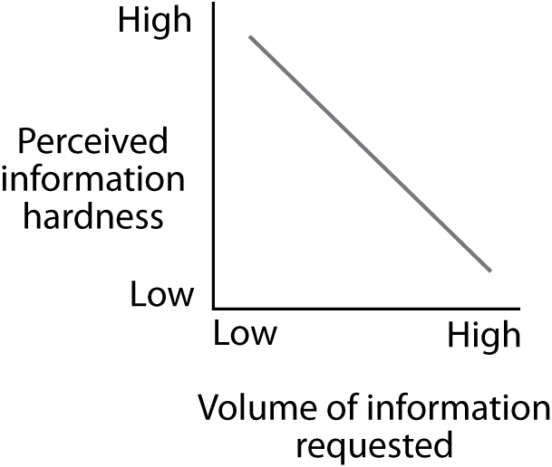
Demand varies with hardness of information
Use multiple sources in search of reliability

Slide 25
Demand varies with responsibilities
S
h
o
r
t
-
t
e
r
m
M
e
d
i
u
m
-
t
e
r
m
L
o
n
g
-
t
e
r
m
i
n
f
o
r
m
a
t
i
o
n
i
n
f
o
r
m
a
t
i
o
n
i
n
f
o
r
m
a
t
i
o
n
O
p
e
r
a
t
i
o
n
a
l
S
e
n
i
o
r
m
a
n
a
g
e
r
e
x
e
c
u
t
i
v
e

Slide 26
Information satisficing
Decision overload is a problem
Satisficing
Accept first satisfactory decision
Collect enough information to make a satisfactory decision
Lowers quality of decision making

Slide 27
Information delivery systems
Organizational memory | Delivery systems
People | Conversation
 | Electronic mail
 | Meeting
 | Report
 | Groupware
Files | Management information system (MIS)
Documents | Office automation system (OAS)
Images | Imaging process system (IPS)
Graphics | Computer aided design (CAD)
 | Geographic information system (GIS)
Voice | Voice mail
 | Voice recording system
Mathematical model | Decision Support System (DSS)
Knowledge | Expert System (ES)
Decisions | Conversation
 | Electronic mail
 | Meeting
 | Report
 | Groupware

Slide 28
Information systems drivers
Drive | Definition | Example
Ubiquity | The drive to access to information unconstrained by time and space | Internet, WiFi, 4G
Uniqueness | The drive to know precisely the characteristics and location of a person or entity | GPS, SIM, RFID, Augmented reality
Unison | The drive for information consistency | Cloud computing, ERP
Universality | The drive to overcome the friction of information systems’ incompatibilities | Smart phone, smart card, ATM card
Notes:
Junglas, I. A., & Watson, R. T. (2006). The U-constructs: Four information drives. Communications of AIS, 17, 569-592.

Slide 29
Organizational memory is fragmented
File
Image
Organizational Memory
People
File
Search
MIS
CMS
E-mail
Information integration software
(e.g., an EIS)
Client

Slide 30
The ideal system
Organizational Memory
Information delivery system
Client

Slide 31
Organizational Knowledge
Cognitive knowledge
Advanced skills
System understanding and trained intuition
Self-motivated creativity
Know what
Know how
Know why
Care why

Slide 32
Skills values vs. training expenditure
Value to the firm
Training expenditure
Cognitive skills (know what)
Advanced skills (know how)
System understanding (know why)
Motivated creativity (care why)

Slide 33
Types of knowledge
Explicit
Codified and transferable
Tacit
Personal, experience, judgment
Difficult to codify
Difficult to transfer

Slide 34
Conclusion
We are about 60 years into the information age
Information-based organizations are the growth engines of advanced economies
Everyone needs information systems skills

